Slide 1
The Digital Logic Level
CHAPTER 3

Slide 2
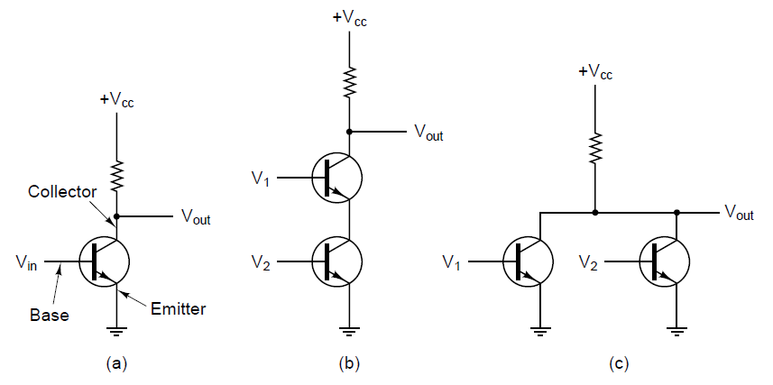
Gates and Boolean Algebra (1)

Slide 3
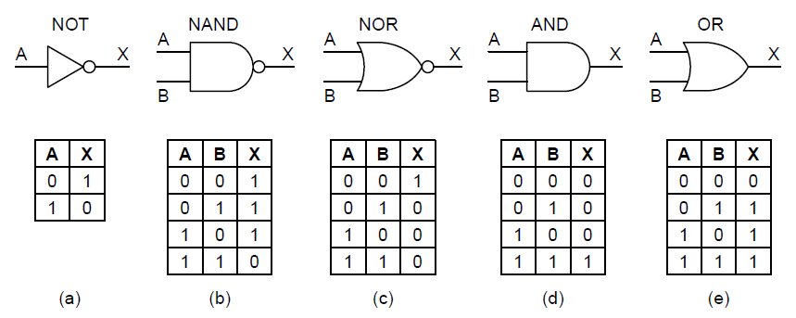
Gates and Boolean Algebra (2)

Slide 4
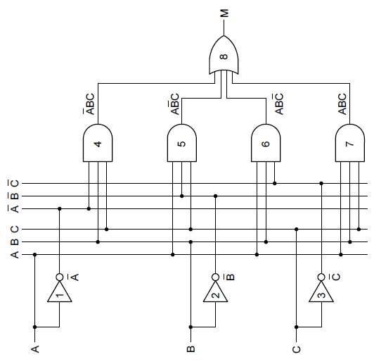
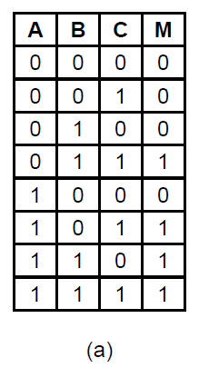
Boolean Algebra
(b)

Slide 5
Implementation of Boolean Functions
Write truth table for function
Provide inverters to generate complement of each input
Draw AND gate for each term with 1 in result column
Wire AND gates to appropriate inputs
Feed output of all AND gates into an OR gate

Slide 6
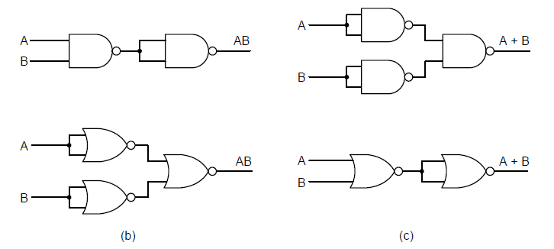
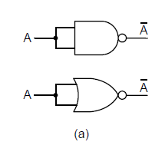
Circuit Equivalence (1)

Slide 7
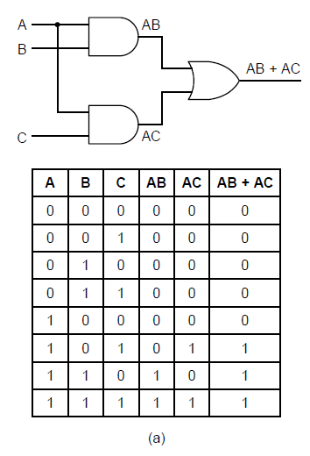
Circuit Equivalence (2)

Slide 8
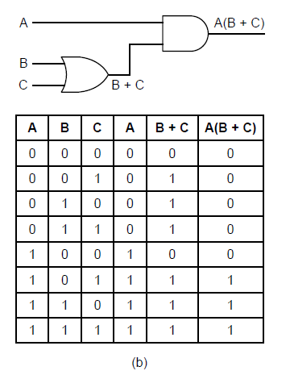
Circuit Equivalence (3)

Slide 9
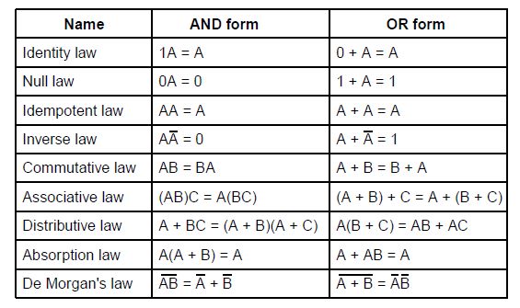
Circuit Equivalence (4)

Slide 10
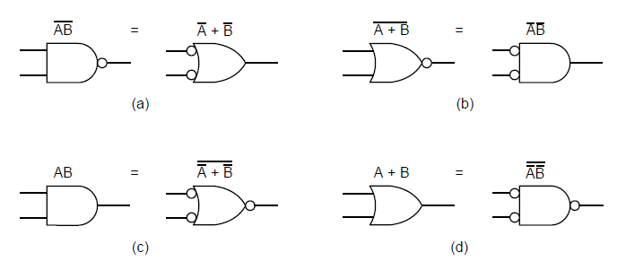
Circuit Equivalence (5)

Slide 11
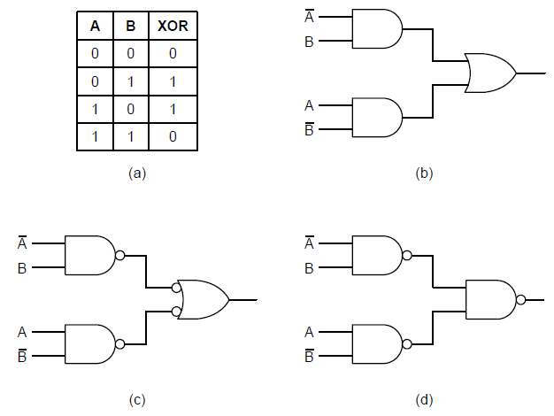
Circuit Equivalence (6)

Slide 12
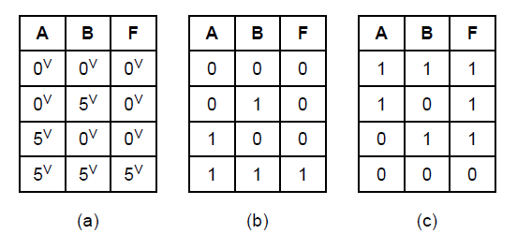
Circuit Equivalence (7)

Slide 13
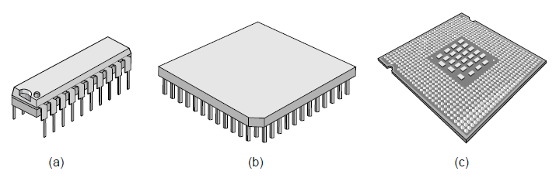
Integrated Circuits

Slide 14
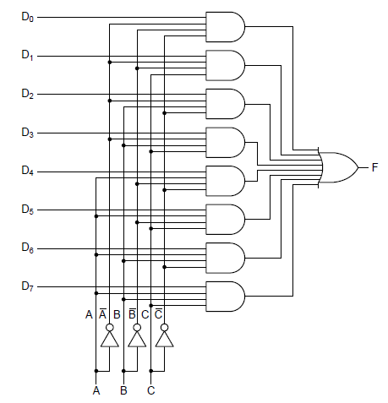
Multiplexers (1)

Slide 15
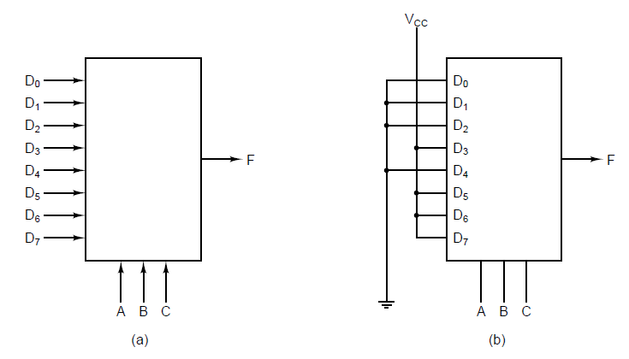
Multiplexers (2)

Slide 16
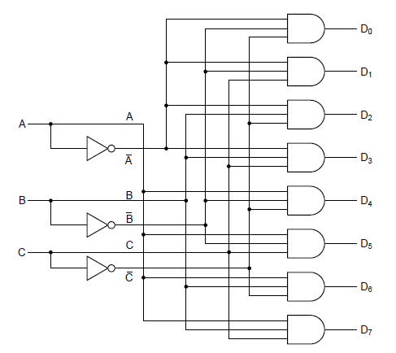
Decoders

Slide 17
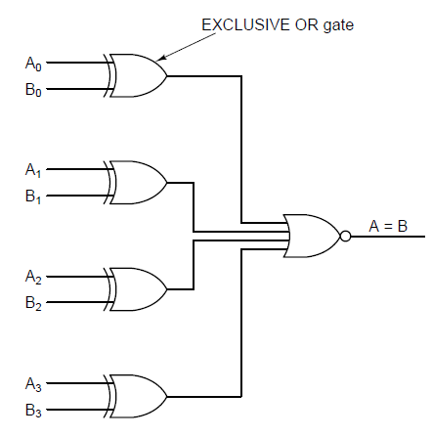
Comparators

Slide 18
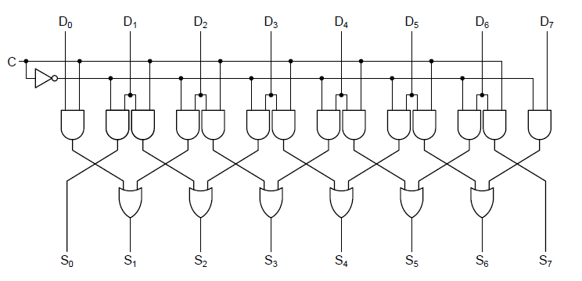
Arithmetic Circuits (1)

Slide 19
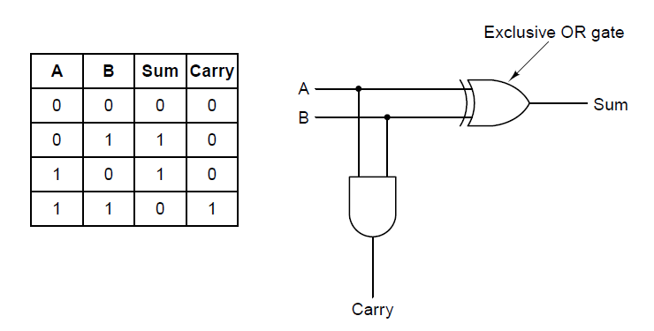
Arithmetic Circuits (2)

Slide 20
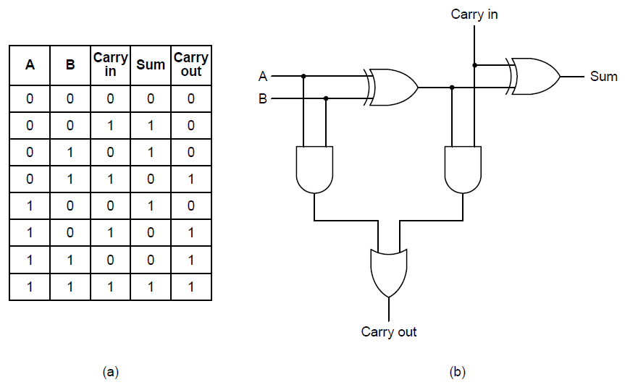
Arithmetic Circuits (3)

Slide 21
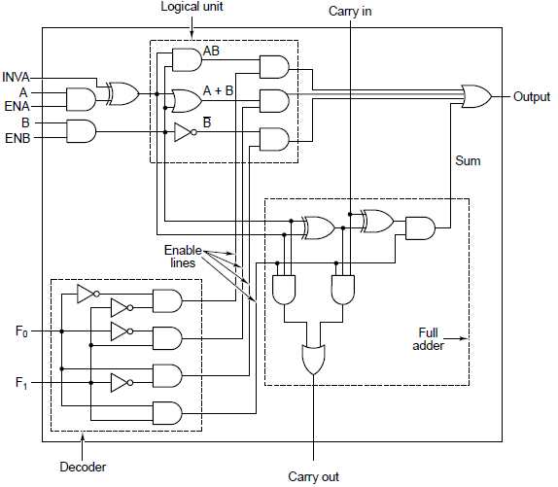
Arithmetic Logic Units (1)

Slide 22
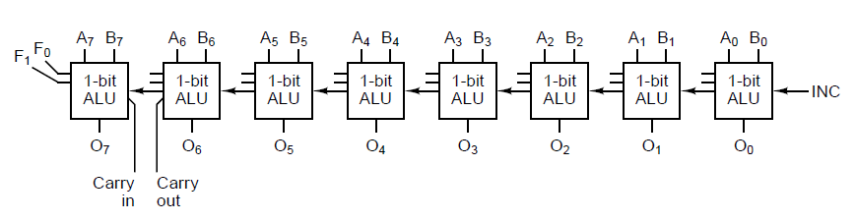
Arithmetic Logic Units (2)

Slide 23
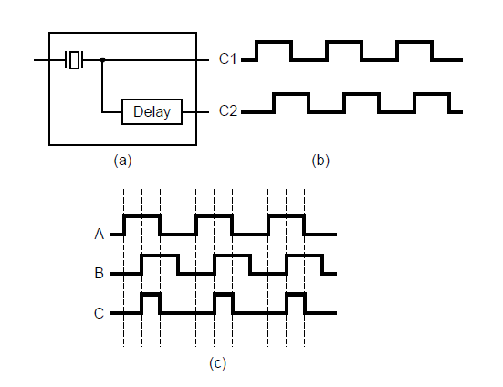
Clocks

Slide 24
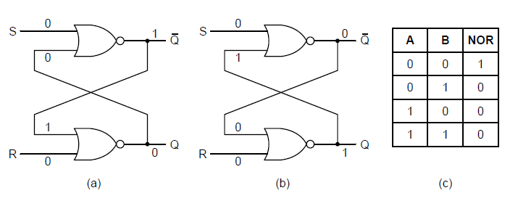
Latches
Figure 3-21. (a) NOR latch in state 0. (b) NOR latch in state 1.
(c) Truth table for NOR.

Slide 25
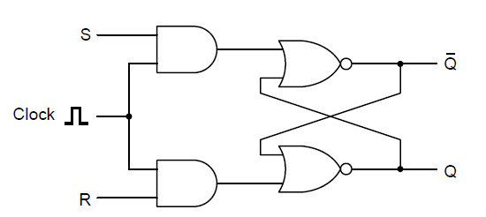
Clocked SR Latches

Slide 26
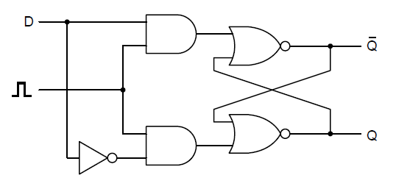
Clocked D Latches

Slide 27
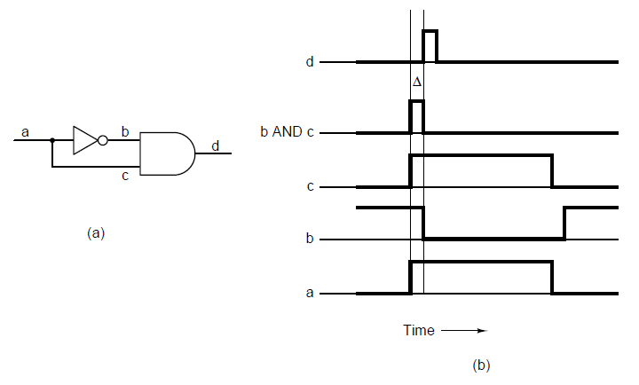
Flip-Flops (1)

Slide 28
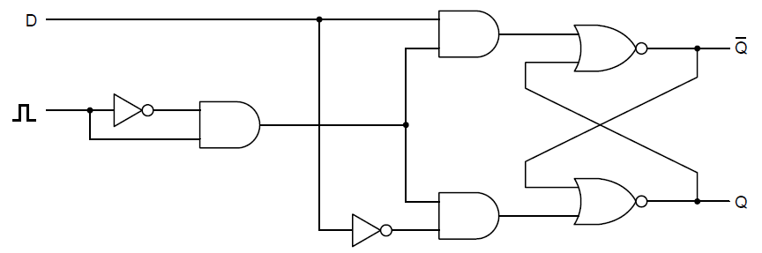
Flip-Flops (2)

Slide 29
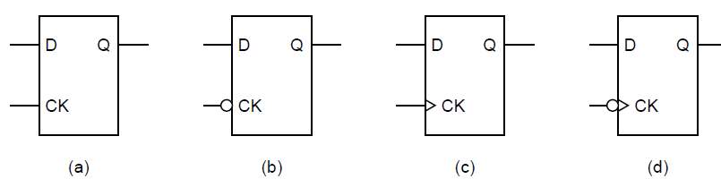
Flip-Flops (3)

Slide 30
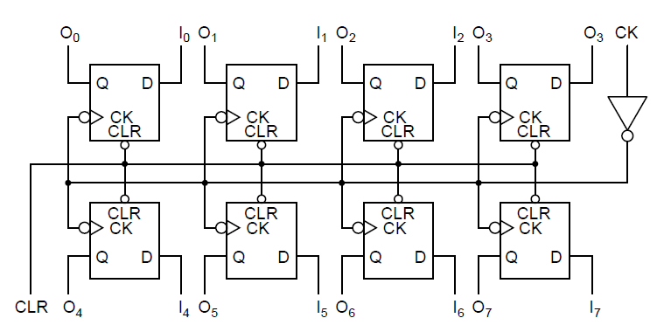
Memory Organization (1)

Slide 31
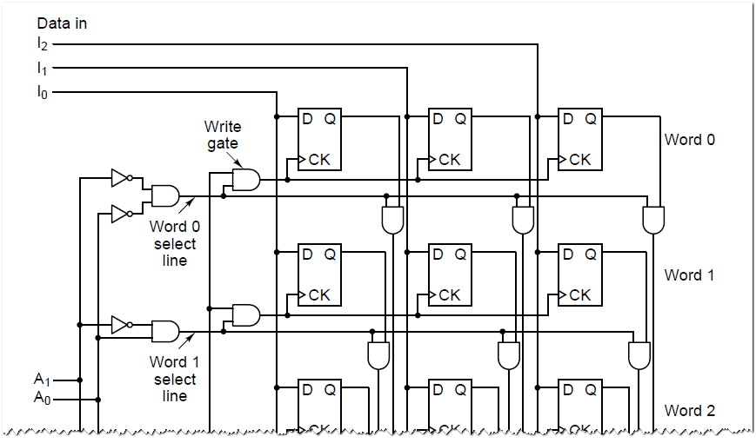
Memory Organization (2a)

Slide 32
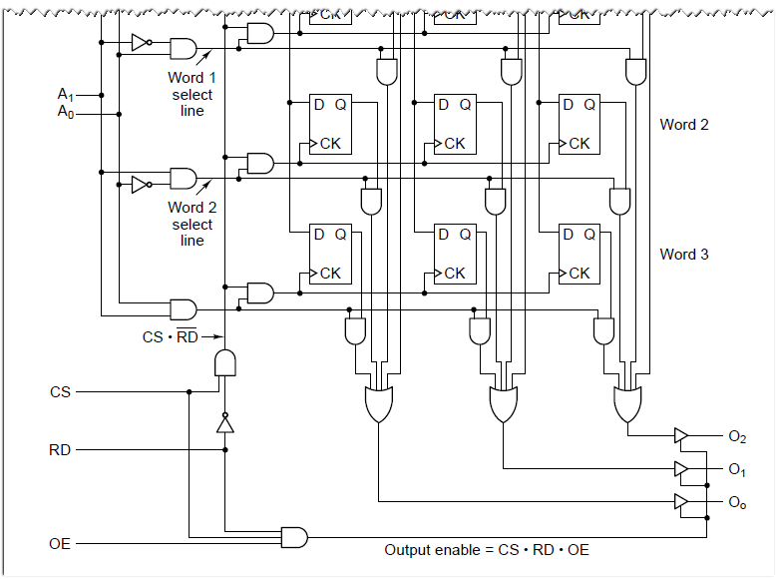
Memory Organization (2b)

Slide 33
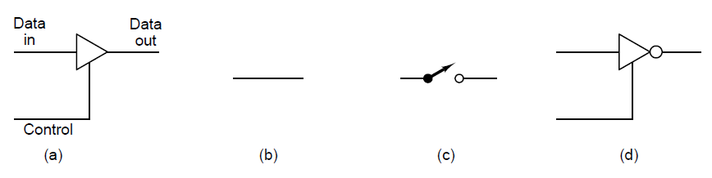
Memory Organization (3)

Slide 34
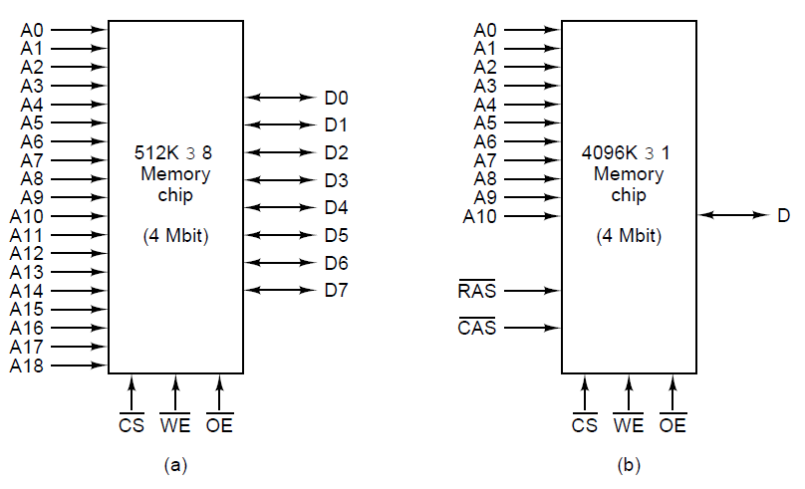
Memory Chips (1)

Slide 35
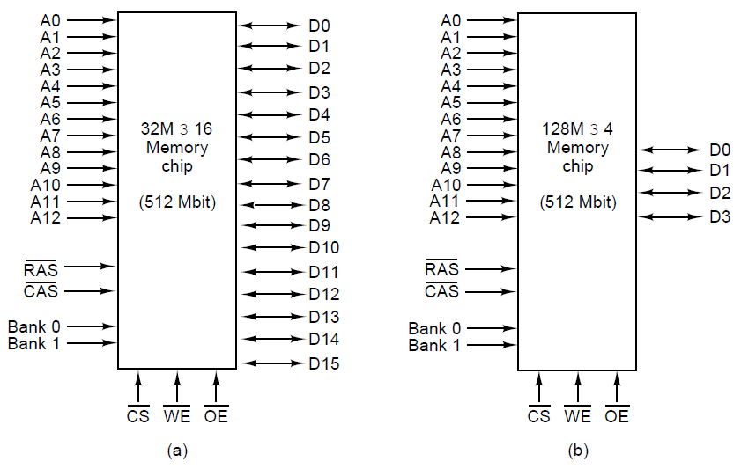
Memory Chips (2)

Slide 36
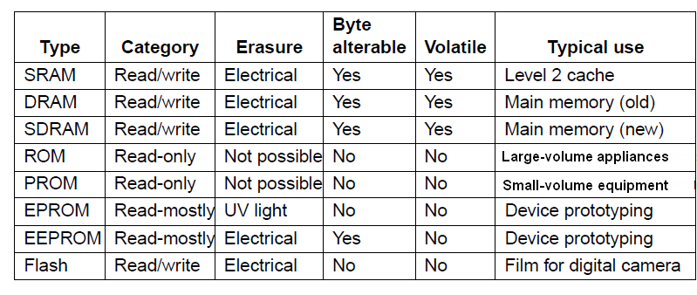
Nonvolatile Memory Chips(2)
Figure 3-32. A comparison of various memory types.

Slide 37
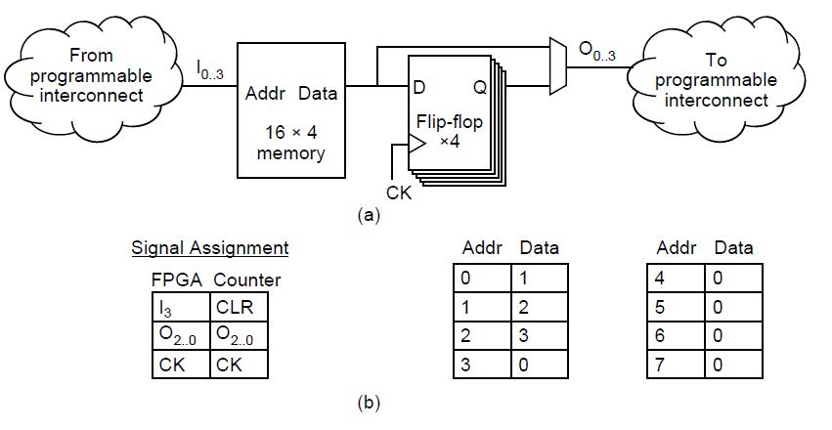
Field-Programmable Gate Arrays

Slide 38
CPU Chip Control Pins
Bus control
Interrupts
Bus arbitration
Coprocessor signaling
Status
Miscellaneous

Slide 39
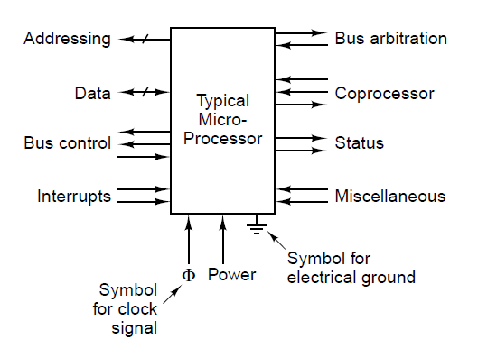
CPU Chips

Slide 40
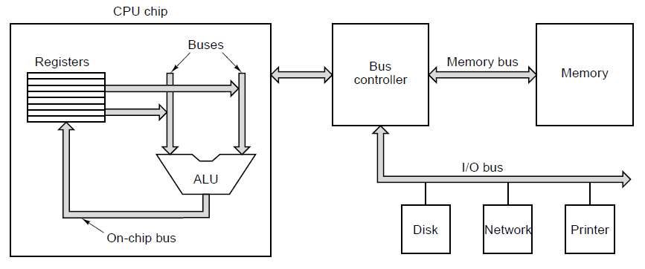
Computer Buses (1)
Figure 3-35. A computer system with multiple buses.

Slide 41
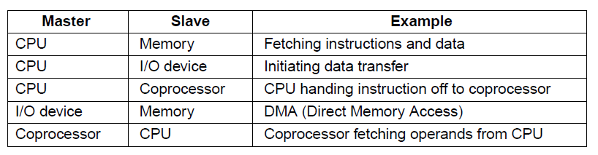
Computer Buses (2)

Slide 42
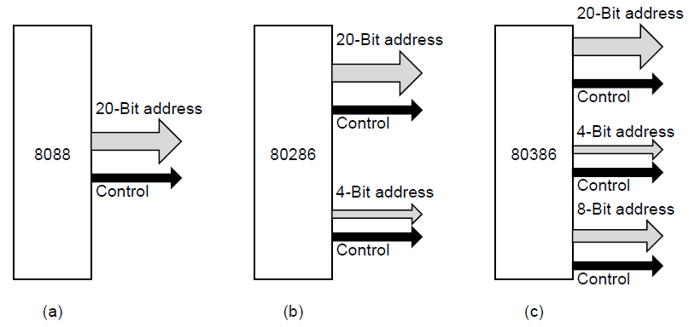
Bus Width

Slide 43
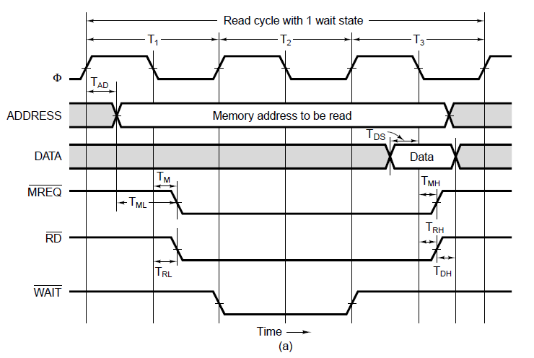
Synchronous Buses (1)

Slide 44
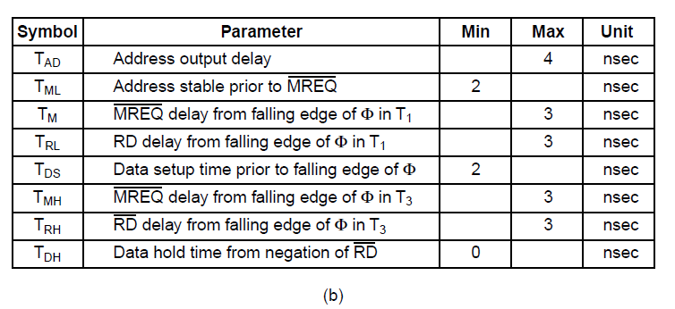
Synchronous Buses (2)
Figure 3-38. (b) Specification of some critical times.

Slide 45
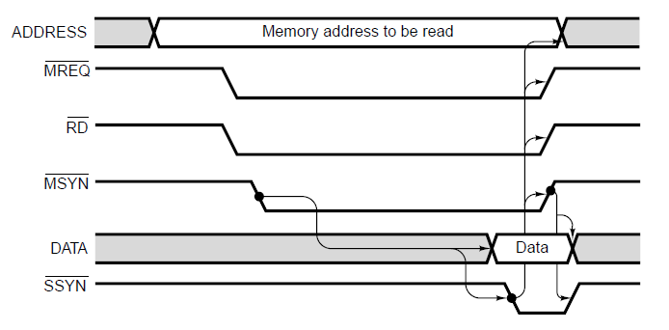
Asynchronous Buses

Slide 46
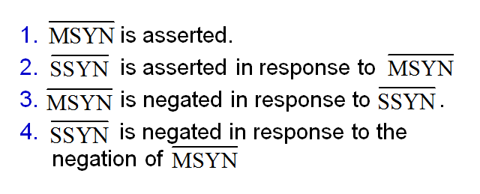
Four Events of Full-Handshake

Slide 47
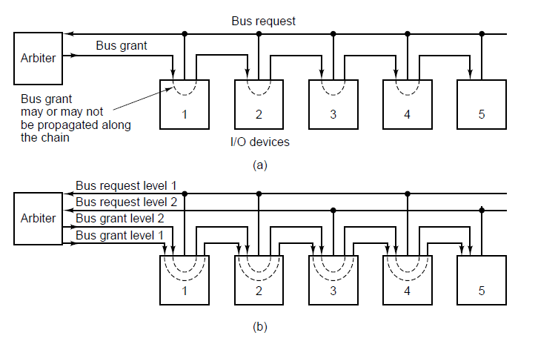
Bus Arbitration (1)

Slide 48
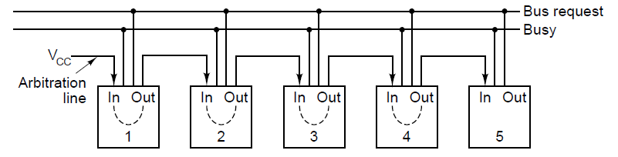
Bus Arbitration (2)

Slide 49
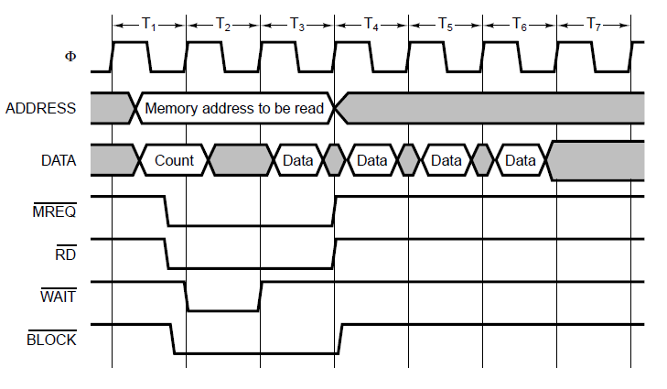
Bus Operations (1)

Slide 50
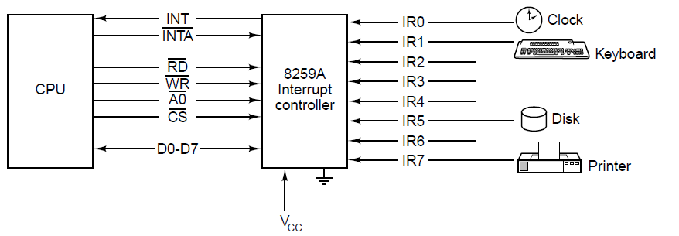
Bus Operations (2)

Slide 51
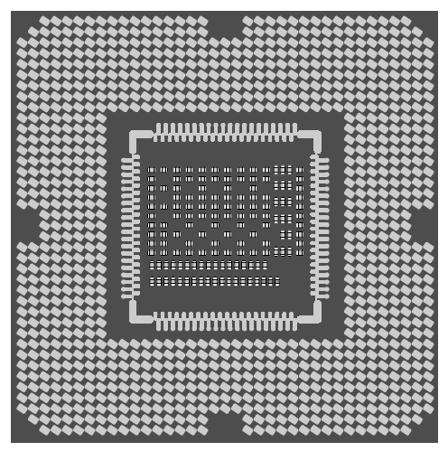
The Intel Core i7

Slide 52

The Core i7’s Logical Pinout

Slide 53
Pipelining on Core i7’s DDR3 Memory Bus
Three steps of memory requests
Activate phase – opens DRAM memory row, ready for access
Read or Write phase – multiple accesses can be made to individual words
Precharge phase – closes DRAM memory row, prepare for next activate

Slide 54

Pipelining

Slide 55

The PCI Bus (1)

Slide 56

The PCI Bus (2a)

Slide 57

The PCI Bus (2b)

Slide 58

PCI Bus Arbitration

Slide 59

PCI Bus Signals (1)

Slide 60

PCI Bus Signals (2)

Slide 61

PCI Bus Transactions

Slide 62

The PCI Express Architecture

Slide 63

The PCI Express Protocol Stack (1)

Slide 64
The PCI Express Protocol Stack (2)
Each transaction uses 1 of 4 address spaces:
Memory space for ordinary reads and writes)
I/O space (for addressing device registers)
Configuration space for system initialization, etc.)
Message space for signaling, interrupts, etc.)

Slide 65
The Universal Serial Bus (1)
Goals of USB developers:
Users must not have to set switches or jumpers
Users must not have to open the case to install new devices
There should be only one kind of cable
I/O devices should get power from the cable
Up to 127 devices should be attachable to a single computer
The system should support real-time devices (e.g., sound)
Devices should be installable while the computer is running
No reboot should be needed after installing a new device
The bus and devices should be inexpensive to manufacture

Slide 66

The Universal Serial Bus (2)
Figure 3-58. The USB root hub sends out frames
every 1.00 msec.

Slide 67

I/O Interfaces

Slide 68

Address Decoding

Slide 69
End
CHAPTER 3

